Slide 1
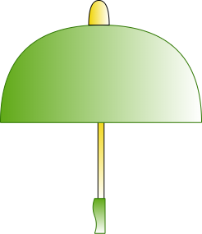
Cooling Humidifier umbrella for
lung cancer and multiple sclerosis patients
Team Members:
Chris Aitken
Chris Barry
Yunke Chen
Jaime Martinez-Diaz
Jason Schwarzwalder
Yizhe Wang
Faculty Supervisor:
Nathalia Peixoto
Course Coordinator:
Peter W. Pachowicz

Slide 2
Introduction/Requirements
The project was to create an umbrella with a built in humidifier
Design
Lightweight
Easy to use
Solar panel implementation
Microcontroller implementation
Function
Supply enough energy through solar panels
Automatically humidifies for user
Keep the user cool underneath the canopy
‹#›

Slide 3
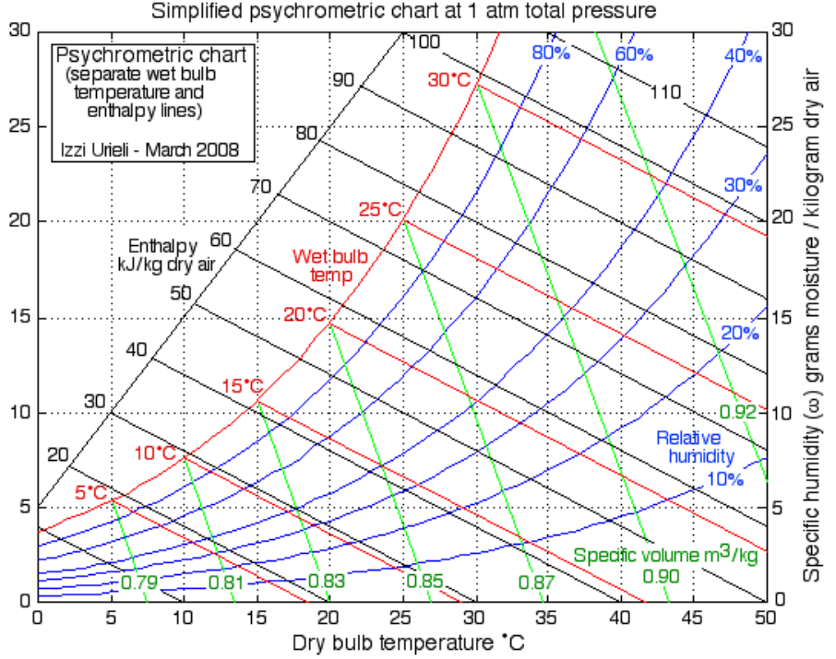
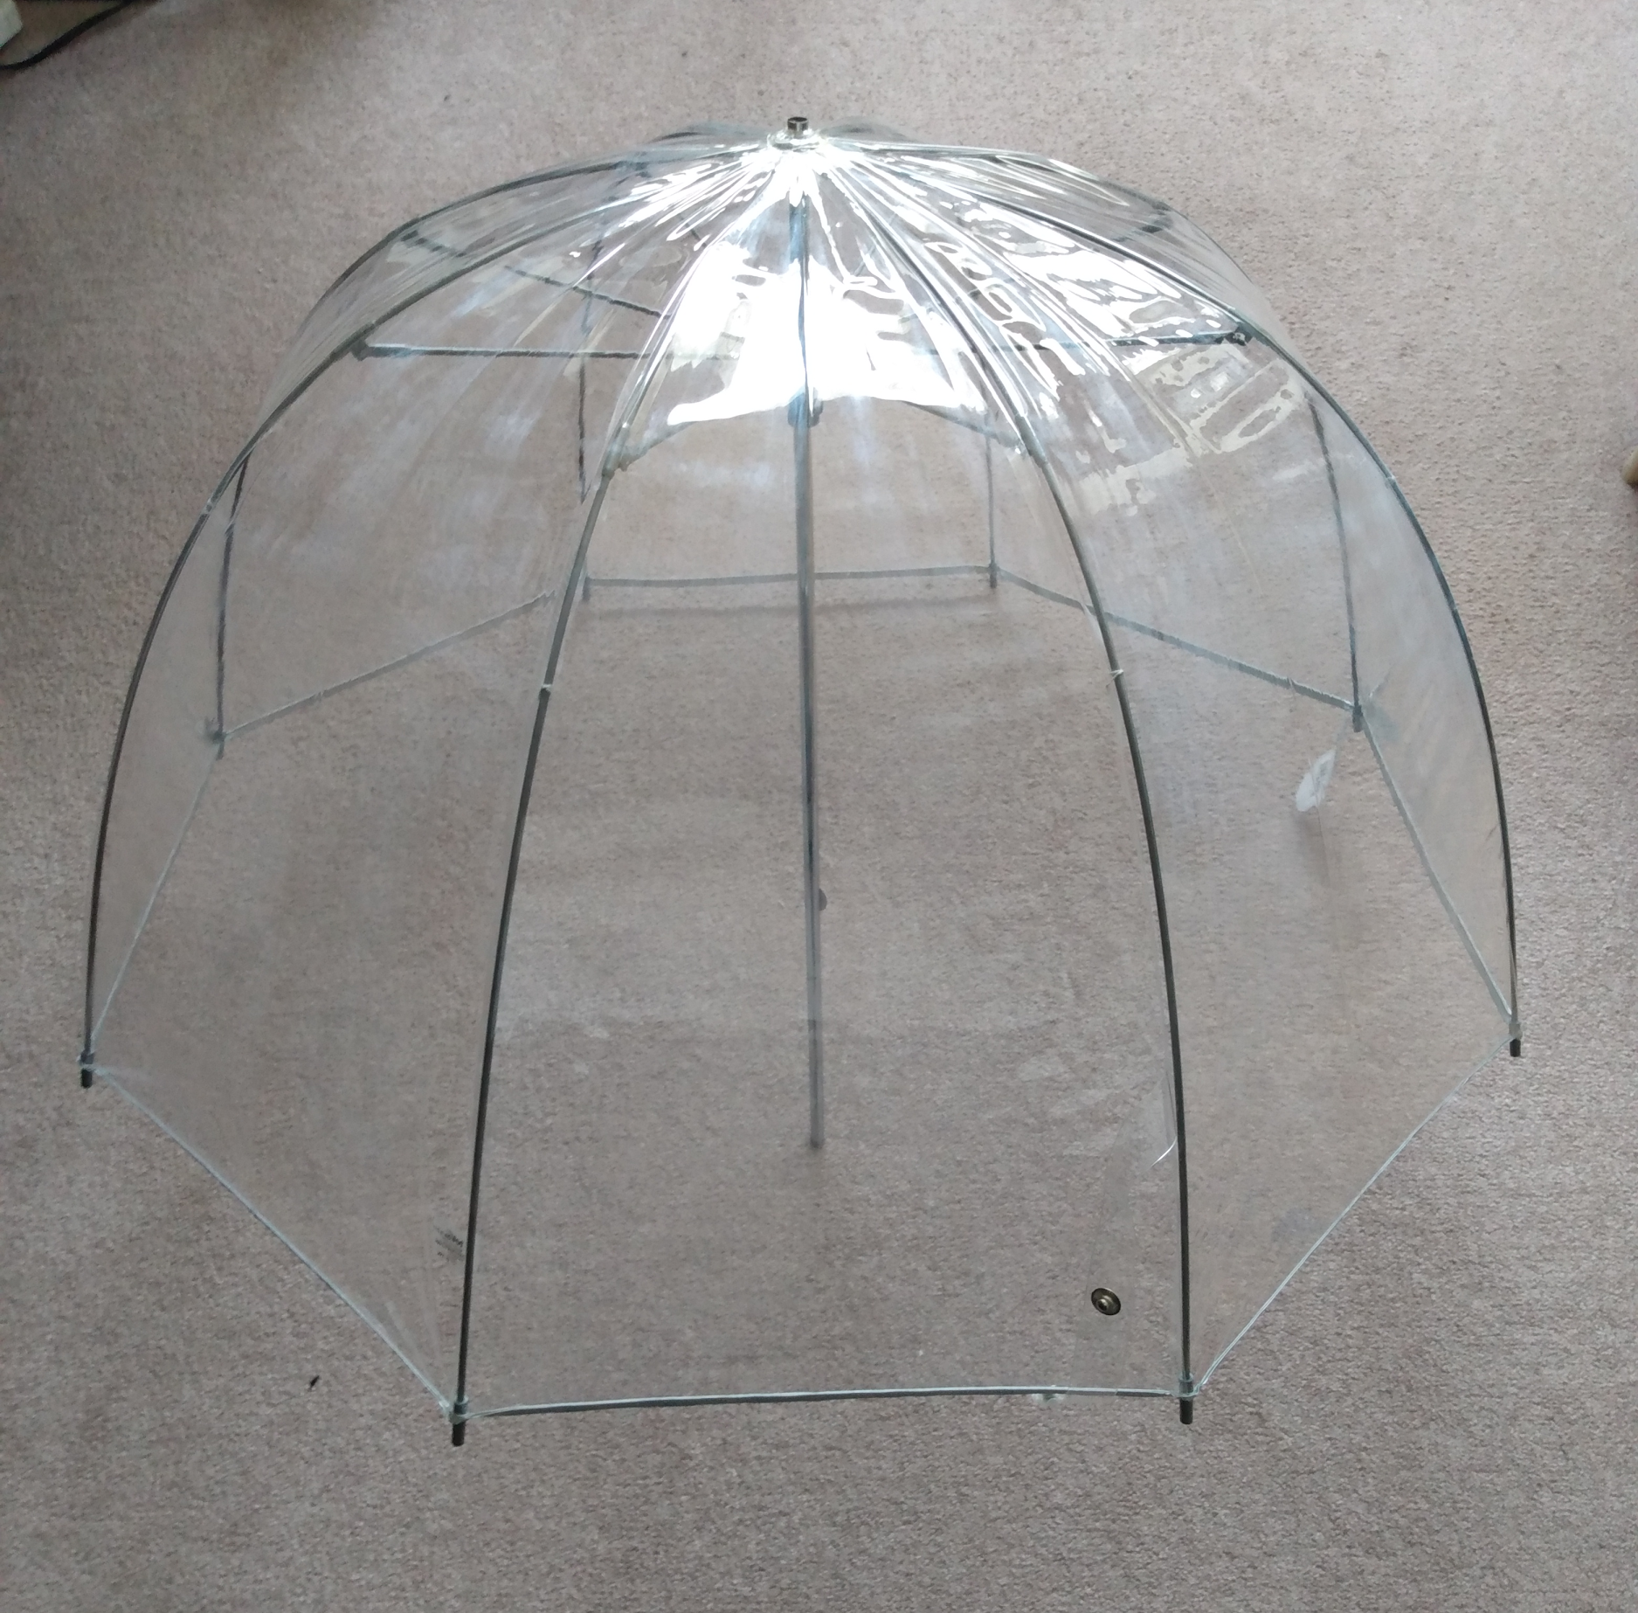
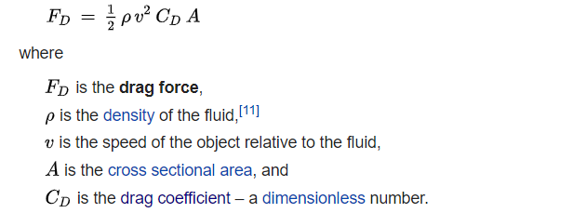
Background Information
Cooling System
Evaporative cooling
Tout = Tdry-(Tdry-Twet)𝜖
Drag Force
Reduce force from winds
‹#›

Slide 4
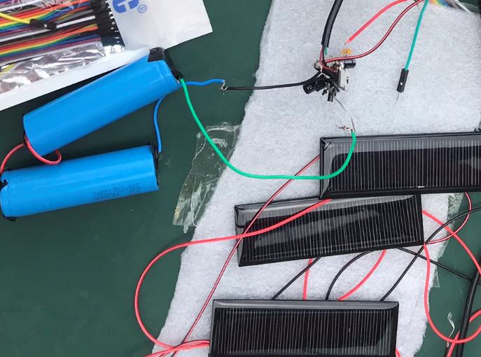
Background Information
Solar Panel
Silicone Sandwiched between conductive layers
Comparator Circuit
Decides which source of power is used
V battery > V solar panel = V battery
V battery < V solar panel = V solar panel
‹#›

Slide 5
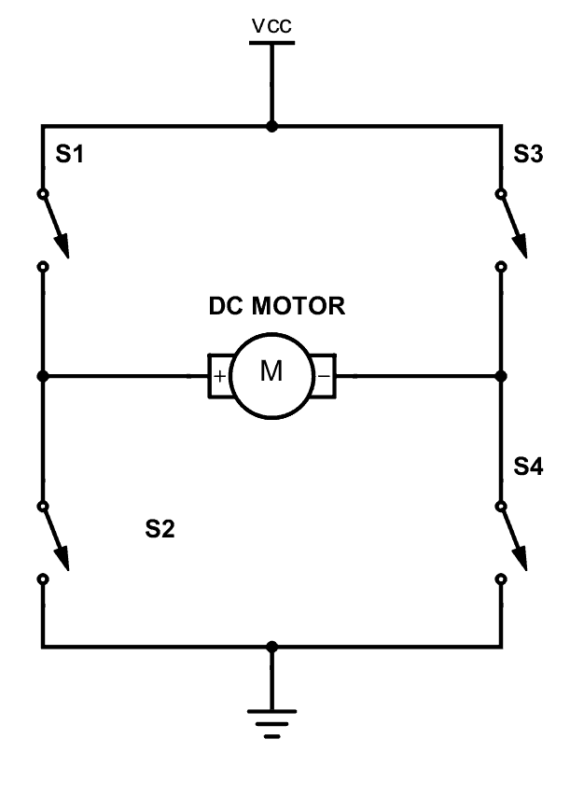
Background Information
Fans
H-Bridge Motor Driver
Four switch configuration to control motor
3D Printing
Polylactic Acid (PLA)
Polyethylene terephthalate glycol-modified(PETG)
‹#›

Slide 6
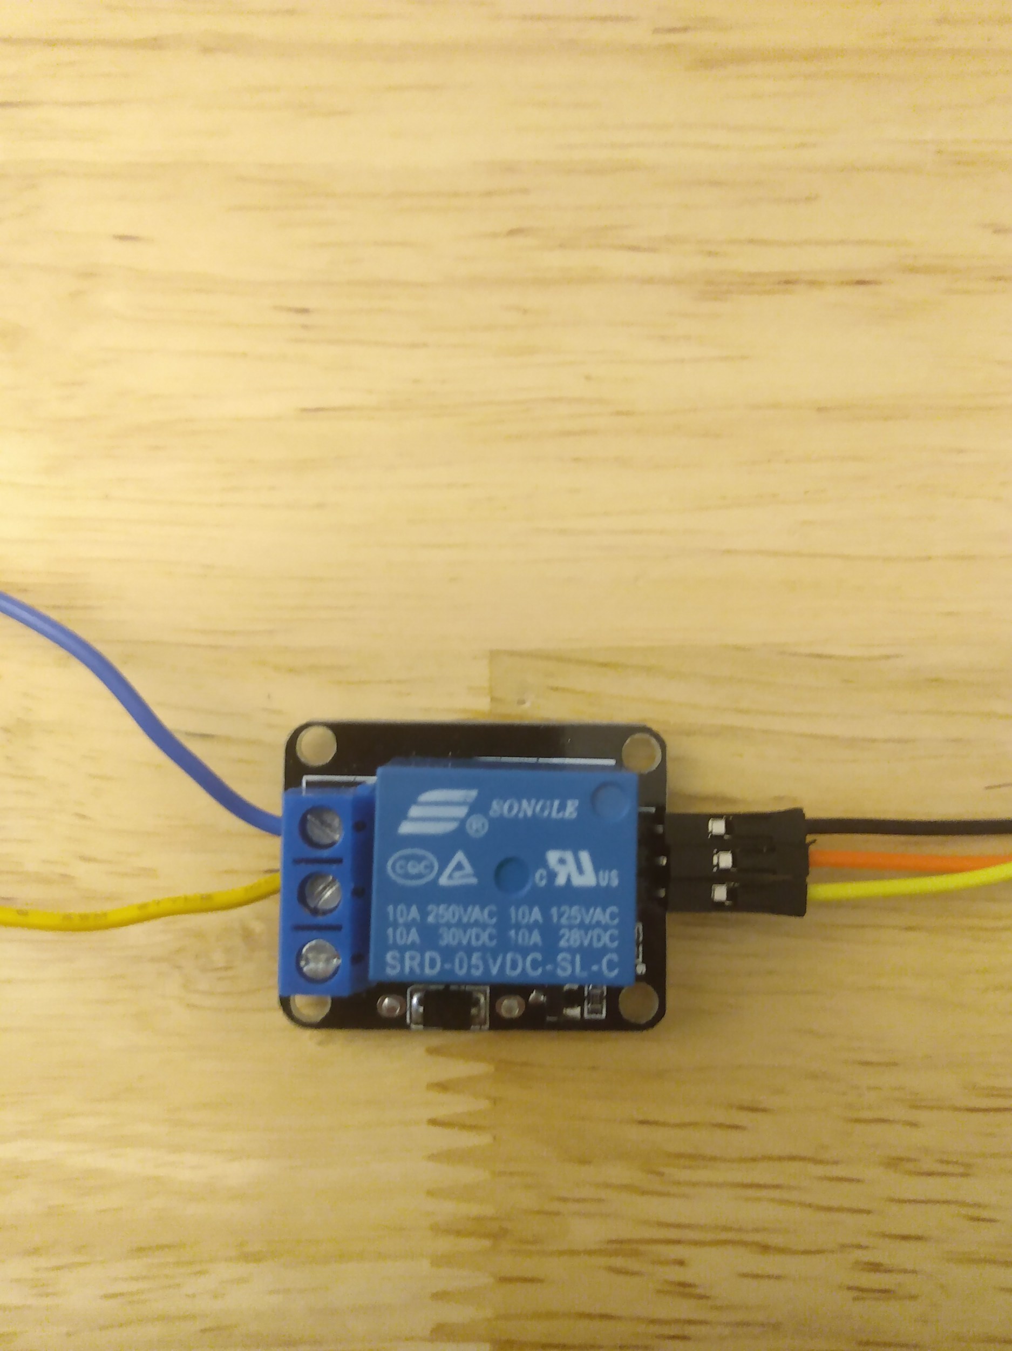
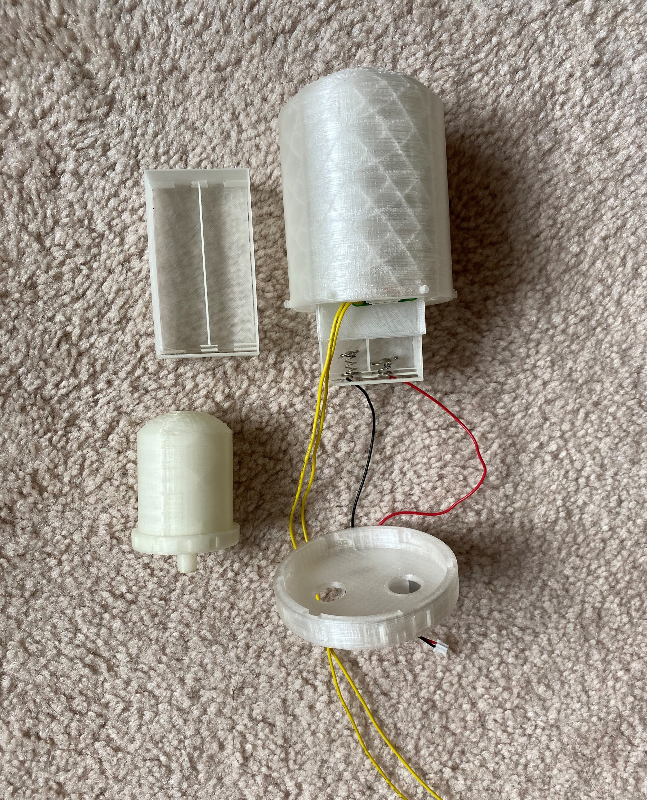
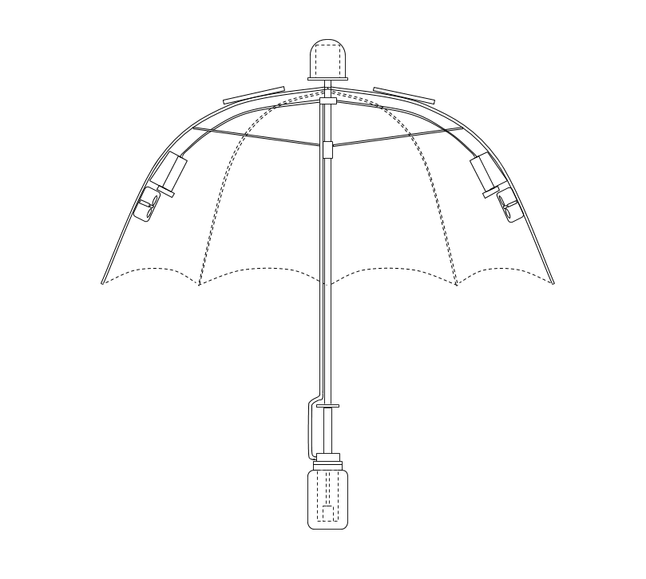
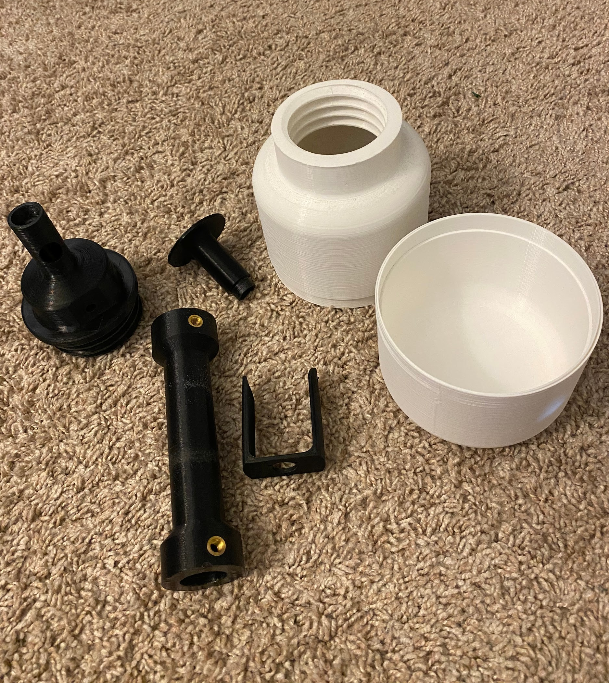
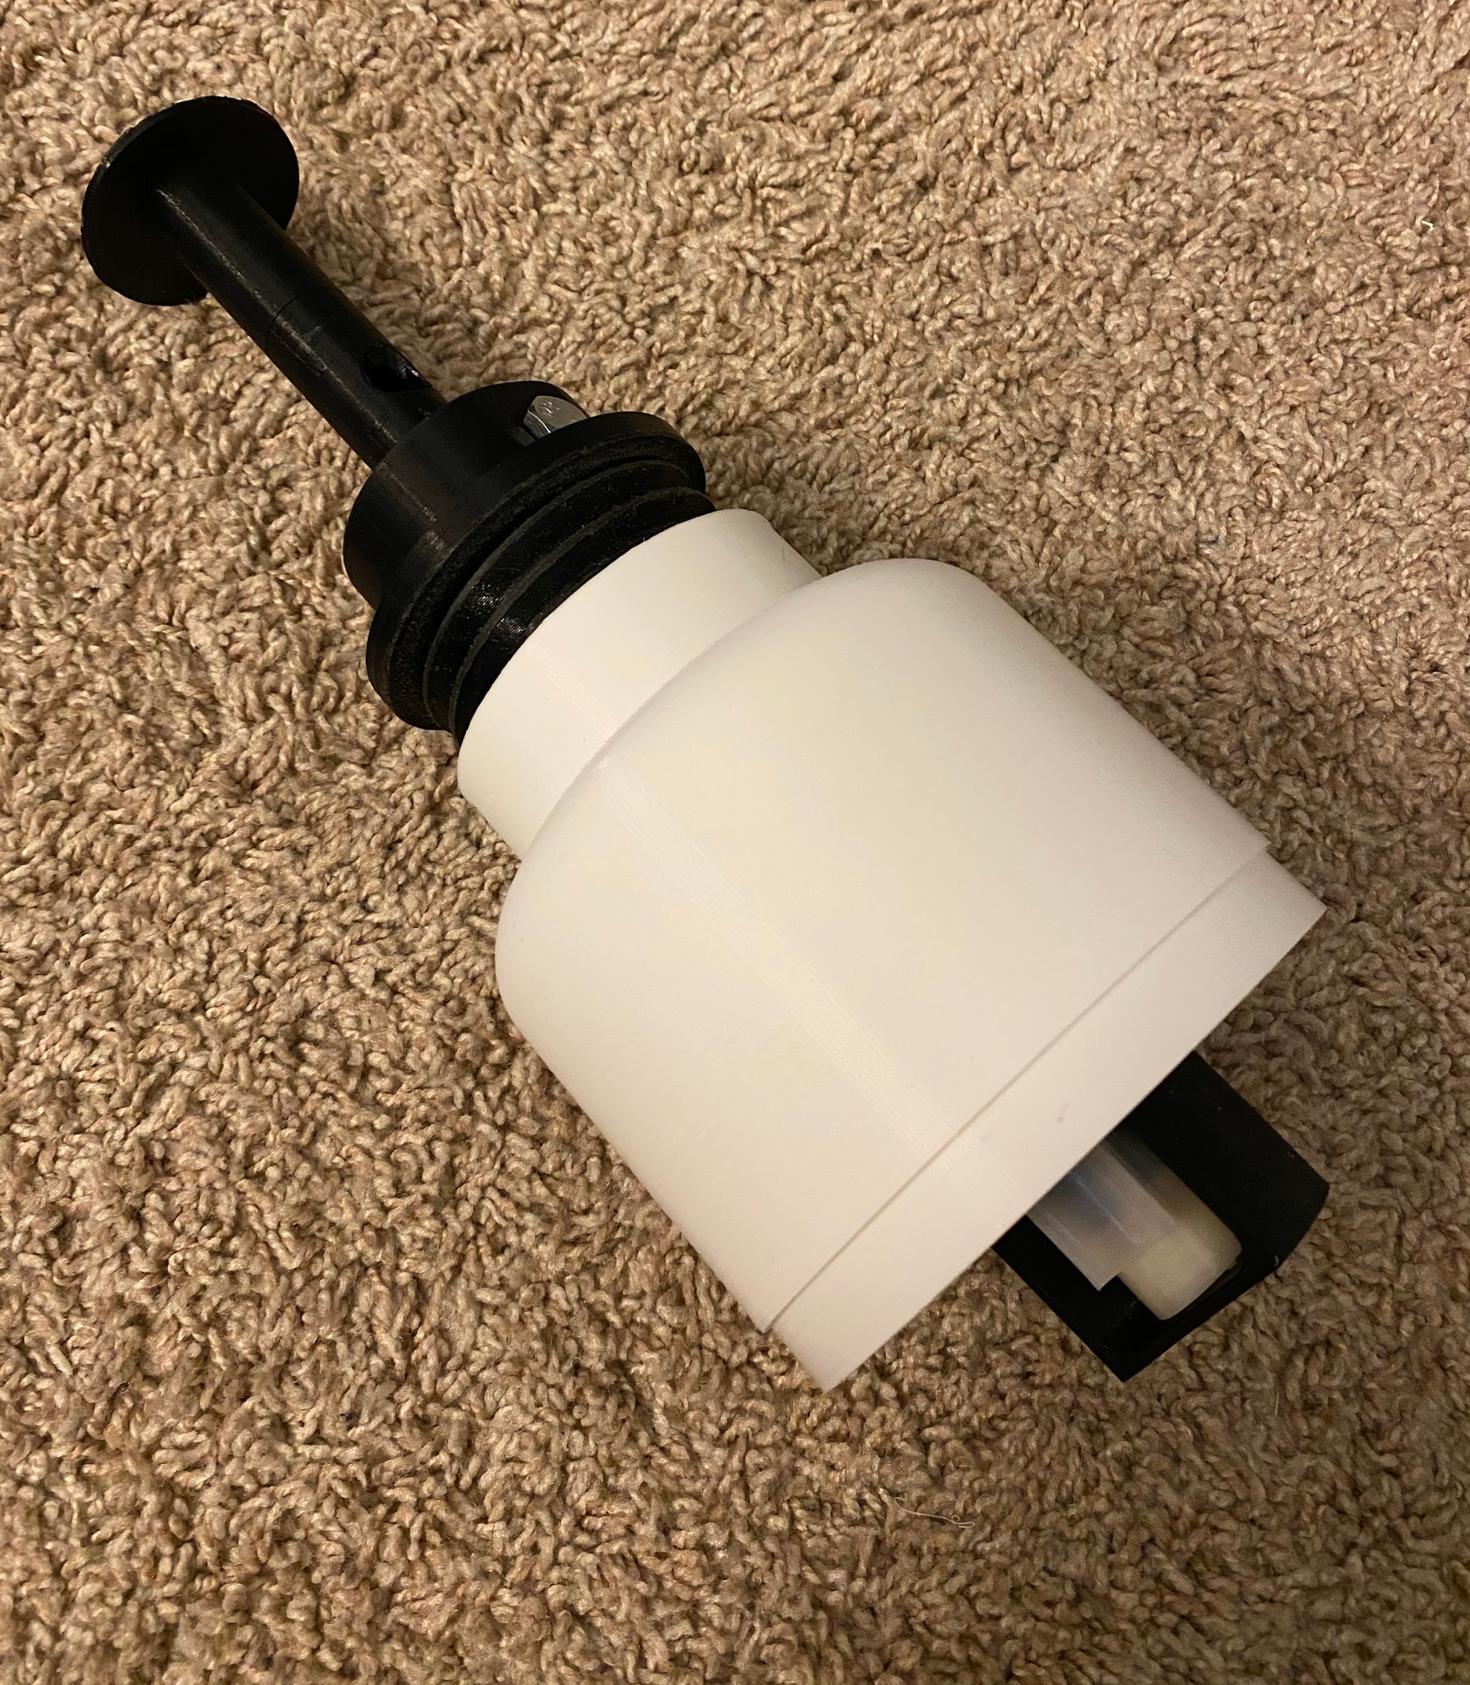
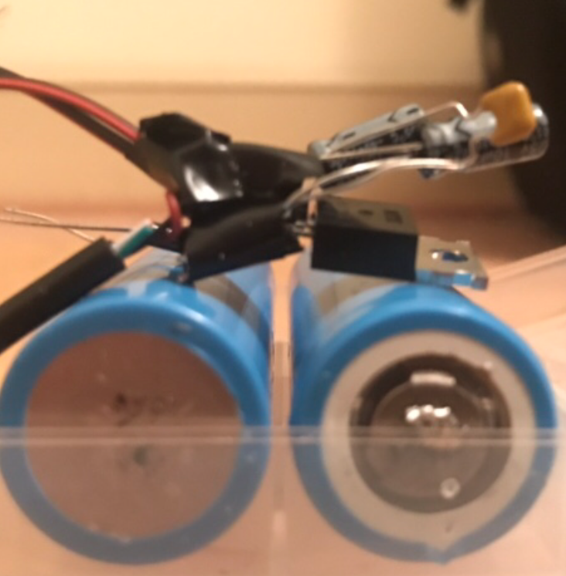
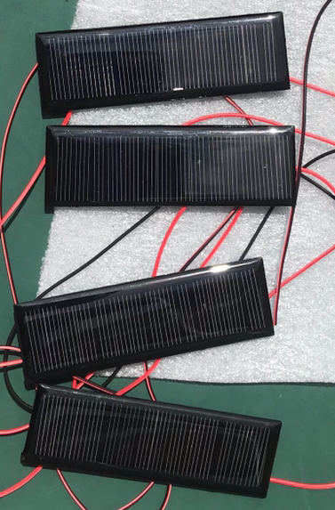
Overall Design
Circuit Breaker
H-Bridge
3D Printed Ferrule
Raspberry Pi
Batteries
Solar Panels
Humidifier
Fan
3D Printed Ferrule
Control Case and Batteries Case
Relay and H-bridge Motor Driver
Humidifier Setup
Water Tube
3D Printed Handle
Batteries, Solar Panels, and Voltage Regulator connected to Diode Circuit
Water bottle with water pump inside
3D Printed Parts of the Handle and Water Bottle

Slide 7
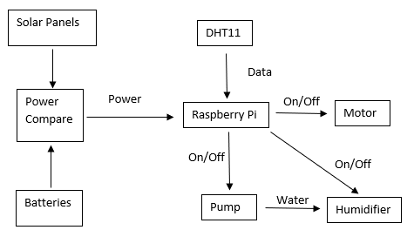
System Architecture
Use Raspberry Pi to control components
Keeps required user interactions minimal
Components can turn on/off independently of each other
‹#›

Slide 8
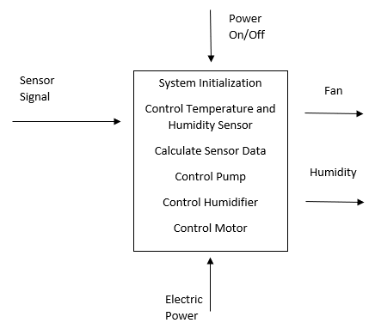
Functional Decomposition: Level 1
Provide humidity to the user
Turn the fan on/off to keep temperature in range
Control multiple different components
‹#›

Slide 9
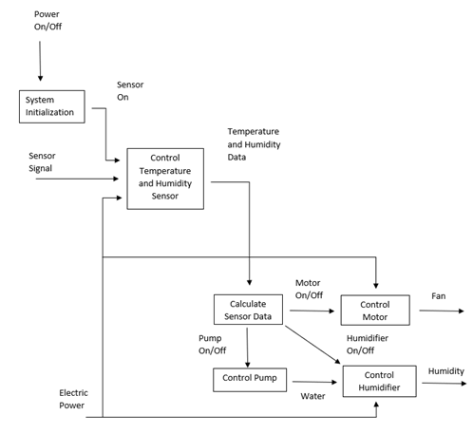
Functional Decomposition: Level 2
Pump and Humidifiers controlled separately
Fan and Humidity feed back in as inputs
Negative feedback loop to get to and stay in acceptable range
‹#›

Slide 10
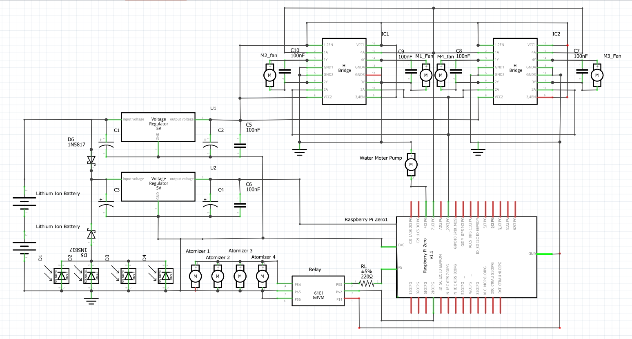
Circuit diagram
‹#›

Slide 11
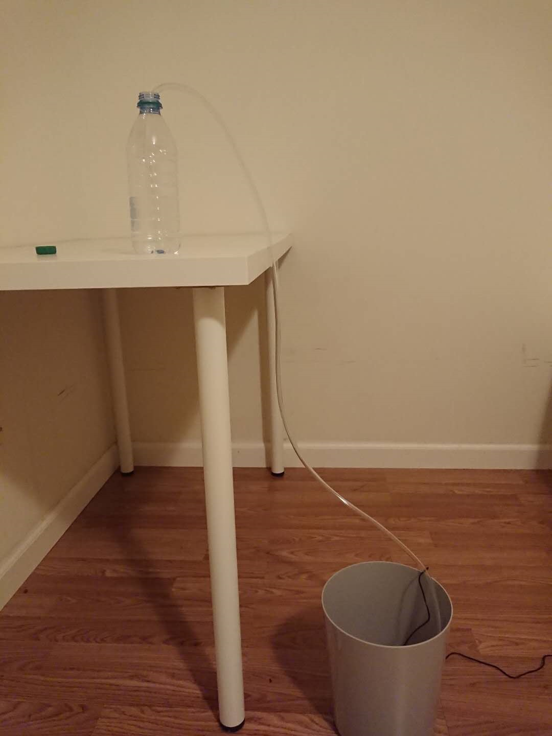
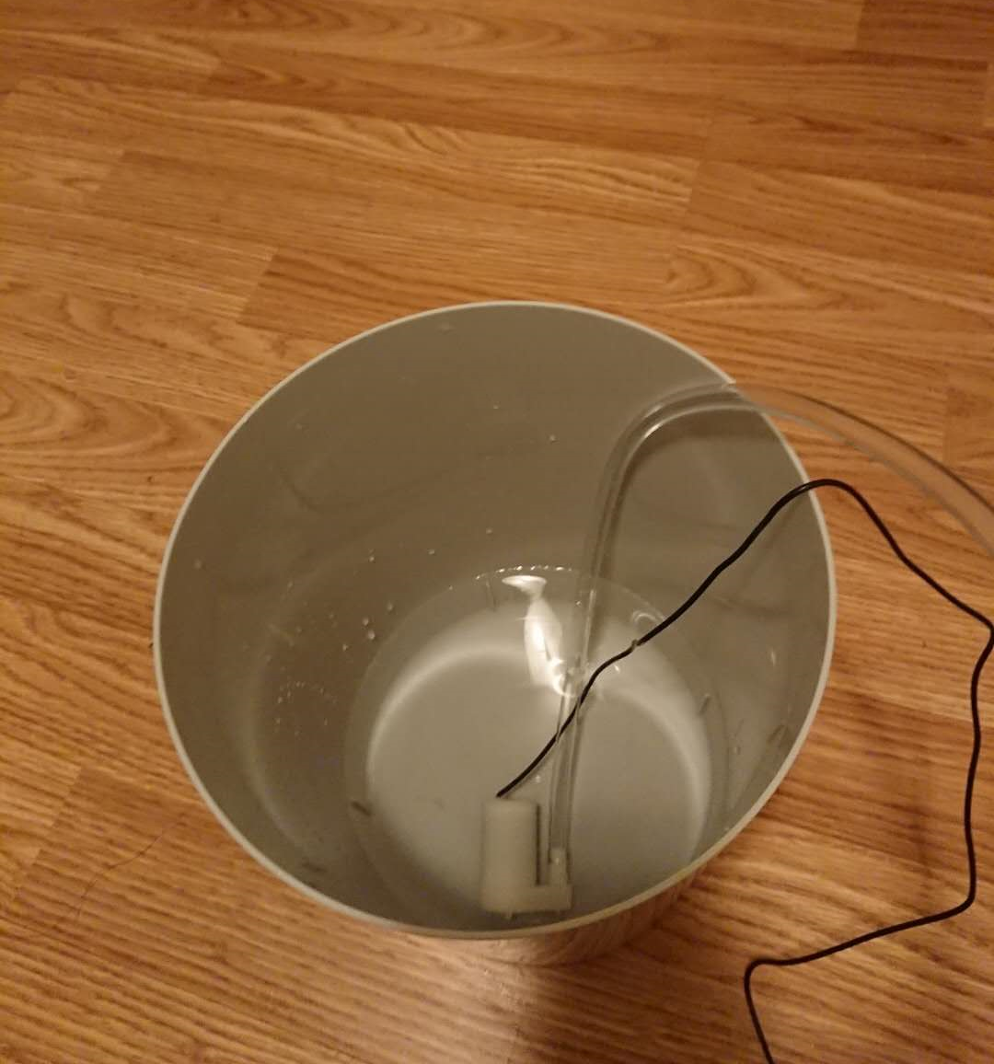
Water transmission and consume test
Water pump tested in different water temperature
8.89 ml/s in room temperature water, 6.67 ml/s in chilled water
‹#›

Slide 12
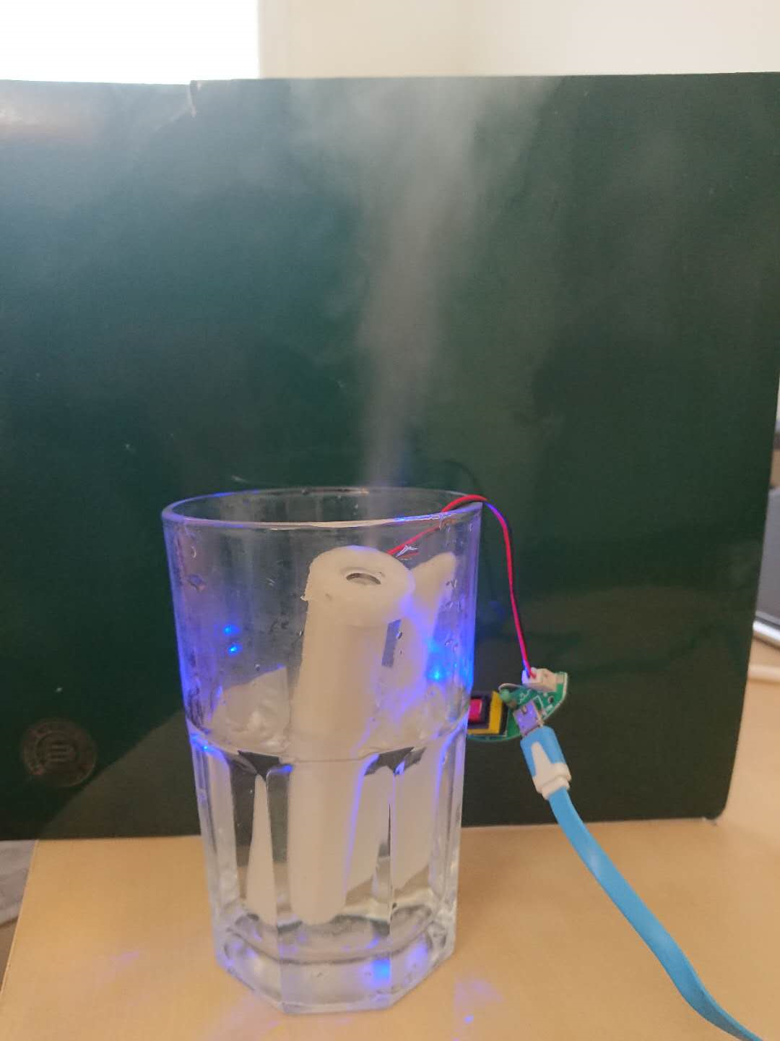
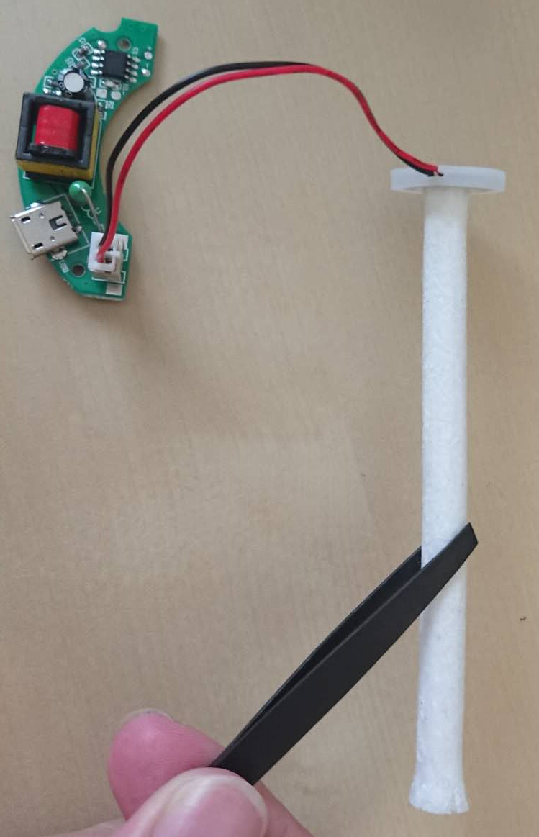
Water transmission and consume test
Water consumption rate of Humidifier
Consumes water at 70 ml/h. At least 2.5 h of useage
Water splitter test and problem
Solved by changing the cross-sectional area
‹#›

Slide 13
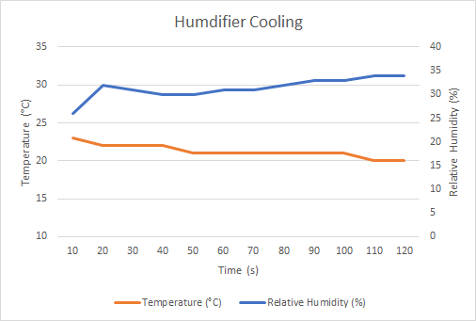
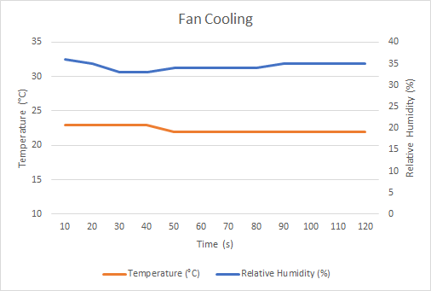
Cooling efficiency test
Testing temperature and humidity change due to humidifier and fan.
Test performed in indoor situation with the temperature of 23°C.
3°C of temperature drop for the humidifier.
1°C of temperature drop for the fan.
‹#›

Slide 14
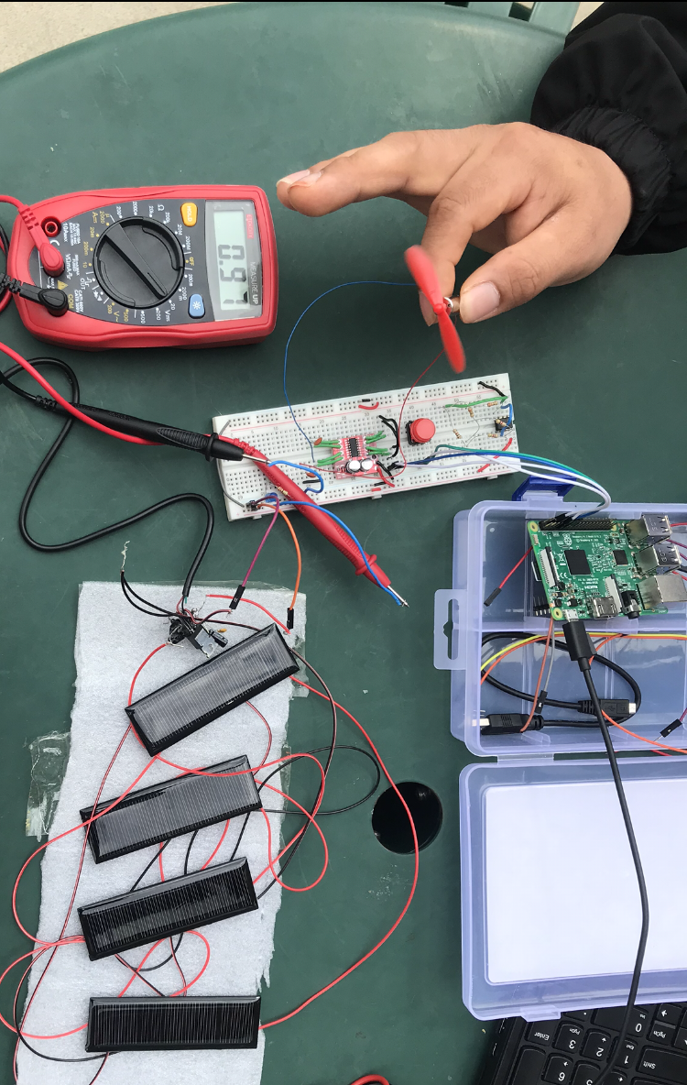
Power System test
Building and testing battery and solar panel voltage and current values
Adding voltage regulator
Testing power system for H-Bridge, added second voltage regulator
Creating diode circuit
‹#›

Slide 15
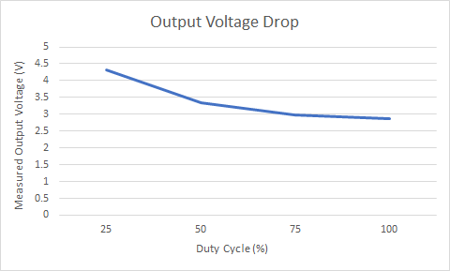
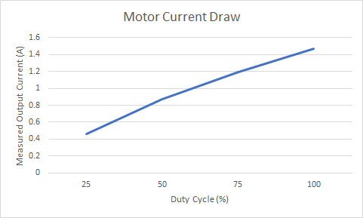
Power System test
Batteries specified voltage: 7.2 volts
Batteries measured voltage: 8.2 volts
Solar panel specified voltage: 7 volts
Solar panel measured voltage: 8.5 volts
5 volt voltage regulator output voltage: 4.99 volts
5 volt voltage regulator max current draw: 1.47A
‹#›

Slide 16
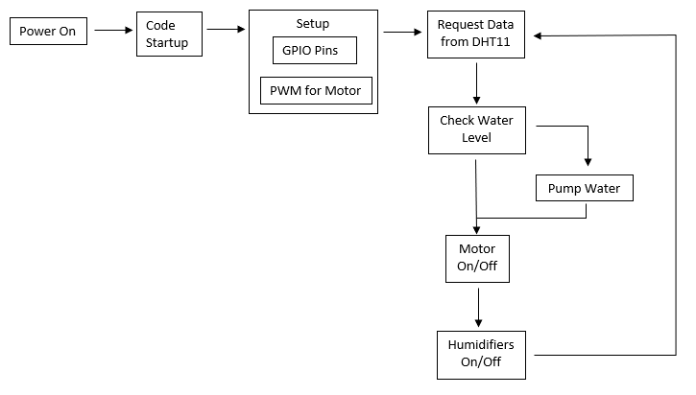
Control System test
Code to interface with components
Verify code on Raspberry Pi 3
Transfer sim card to Raspberry Pi Zero for final design
‹#›

Slide 17
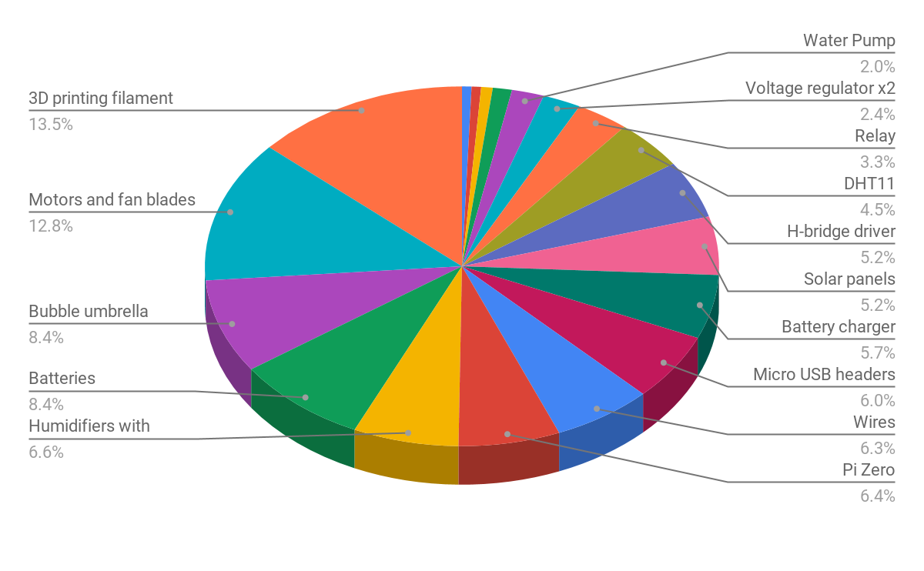
Cost Breakdown
‹#›
Total cost: $165.69

Slide 18
Man Hours and Team Contribution
Water pump
Handle
Fans and motors
Water Bottle
Cooling System
Jaime Martinez-Diaz
Yizhe Wang
Umbrella Construction
Chris Aitken
Yunke Chen
Atomizer
Ferrule
Solar panels
Power System
Chris Barry
Control System
Jason Schwarzwalder
Raspberry Pi
Batteries regulation
Control Coding
Individual Works: ~460 Hrs
Meeting and Team base Works: 133.5 Hrs
3D Printing:159.5 Hrs
Total hours: 753 Hrs
‹#›

Slide 19
Lessons Learned
Utilizing the Raspberry Pi Zero efficiently
Some components cannot be connected to the Pi directly
Function of a H-bridge
Cannot safely charge lithium-ion batteries in series
The vast options there are when splicing a 3d model for a better print
Working and brainstorming as a team
Balancing the specifications of the design according to the requirements of the project
‹#›

